Slide 1
Project 1
CIS 3250
Leila Corrales
09/25/2026

Slide 2
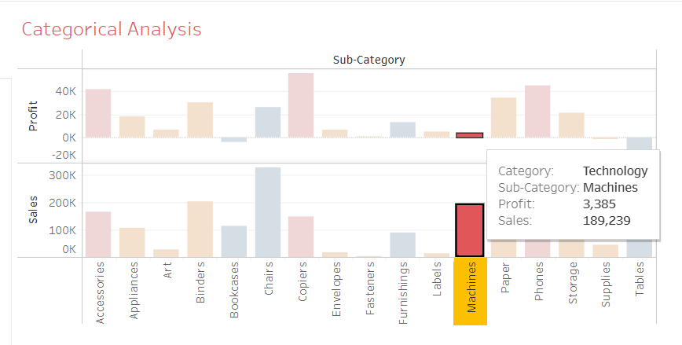
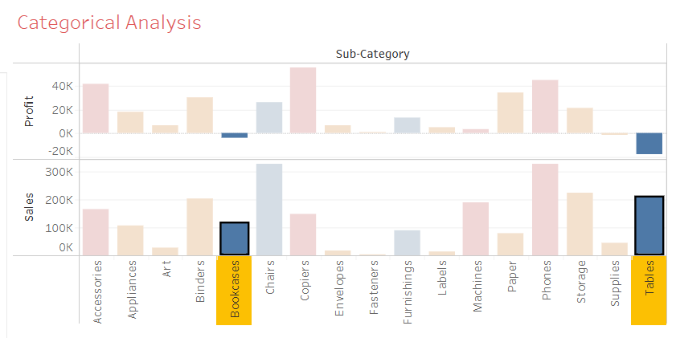
Key Insights & Recommendation
Bullet Point 1: Most of the profit comes from Technological Sales; specifically Phones and Copiers. However, the photo below shows that “Machines” tend to sell high but at a low price. We also notice that Bookcases and Tables tend to sell high, but the company loses money instead of profiting.

Slide 3
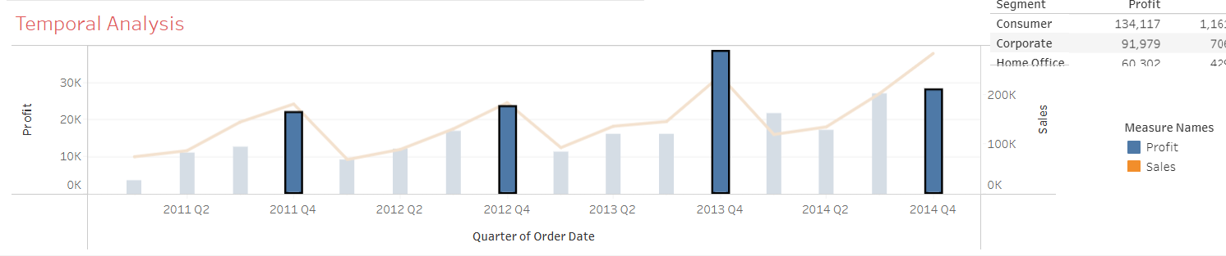
Key Insights & Recommendation
Bullet Point 2: We notice that Profit and Sales decrease every Fourth Quarter of each year. This trend can help the company adjust prices knowing that demand and sales will be increasing. We can also deduce that sales are up due to Christmas, Thanksgiving, and Halloween being major holidays where consumers may spend more money for celebrations.

Slide 4
Key Insights & Recommendation
Business Recommendation:
The company should consider halting the sales of furniture. Majority of the sub category for furniture is losing money instead of gaining money.
The company should consider price adjustments depending on the time of year, raising the price when demand is high and lowering them when it is low.
The company should also consider selling more in Regions like California and New York, as they tend to have higher demand and a bigger market.

Slide 5
Technical Reflection
Data Challenge & Solution: I struggled with creating the layout for my dashboard. I had 4 initial plots and I couldn’t properly fit them in the layout. In order to solve this, I had to remake the analysis I had for the product categories. I struggled because it was difficult to find a way to visualize two categorical values and two numerical values concisely. I ended up sticking with a scatter plot which took up space, but I made sure to remove white spaces in the axes and the data, finally fitting my layout properly.
Link to Tableau Dashboard: https://public.tableau.com/views/Book1_17903841169930/Dashboard1?:language=en-US&publish=yes&:sid=&:redirect=auth&:display_count=n&:origin=viz_share_link

Slide 6
Extra
Google Document of my drafts:
https://docs.google.com/document/d/1G-yxmWC6SVf1sZUzW5Dm7sGXa72KjiM_CvA3KF0iCOM/edit?usp=sharing

